Slide 1

A question of state
What does “state” mean in a distributed / microservices architecture

Slide 2

Local & deterministic
* Well defined unambiguous state

Slide 3

“Service” level

Slide 4
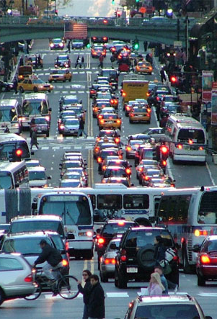
“System” level

